Slide 1
4.1 Process Modeling
Creating Data Flow Diagrams (DFDs) to define business processes.
Levels of DFDs: Context diagrams, Level 0, and Level 1 DFDs.
Process description and validation of models.
4.2 Data Modeling
Introduction to Entity-Relationship Diagrams (ERDs) for database modeling.
Elements of ERDs: Entities, attributes, relationships.
Creating and normalizing ERDs, and balancing ERDs with DFDs.
Data dictionary

Slide 2
Data Modeling
Entity Relationship Diagram
Entity Relationship Diagram, also known as ERD, ER Diagram or ER model, is a type of structural diagram for use in database design.
An ERD contains different symbols and connectors that visualize two important information: The major entities within the system scope, and the inter-relationships among these entities.
When we talk about entities in ERD, very often we are referring to business objects such as people/roles (e.g. Student), tangible business objects (e.g. Product), intangible business objects (e.g. Log), etc. "Relationship" is about how these entities relate to each other within the system.

Slide 3
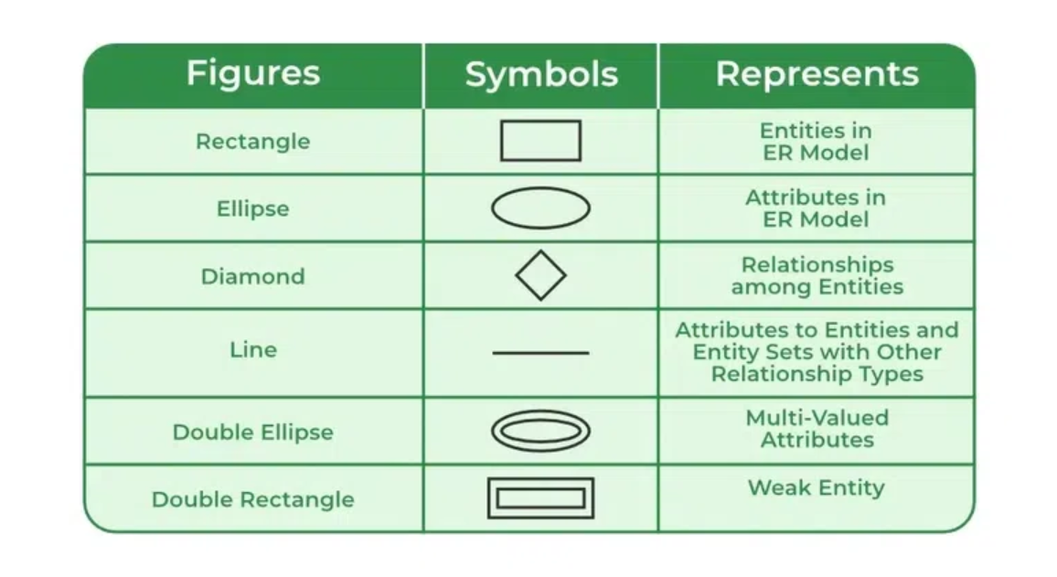
Symbols Used in ER Model
ER Model is used to model the logical view of the system from a data perspective which consists of these symbols:
Rectangles: Rectangles represent Entities in the ER Model.
Ellipses: Ellipses represent Attributes in the ER Model.
Diamond: Diamonds represent Relationships among Entities.
Lines: Lines represent attributes to entities and entity sets with other relationship types.
Double Ellipse: Double Ellipses represent Multi-Valued Attributes.
Double Rectangle: Double Rectangle represents a Weak Entity.

Slide 4
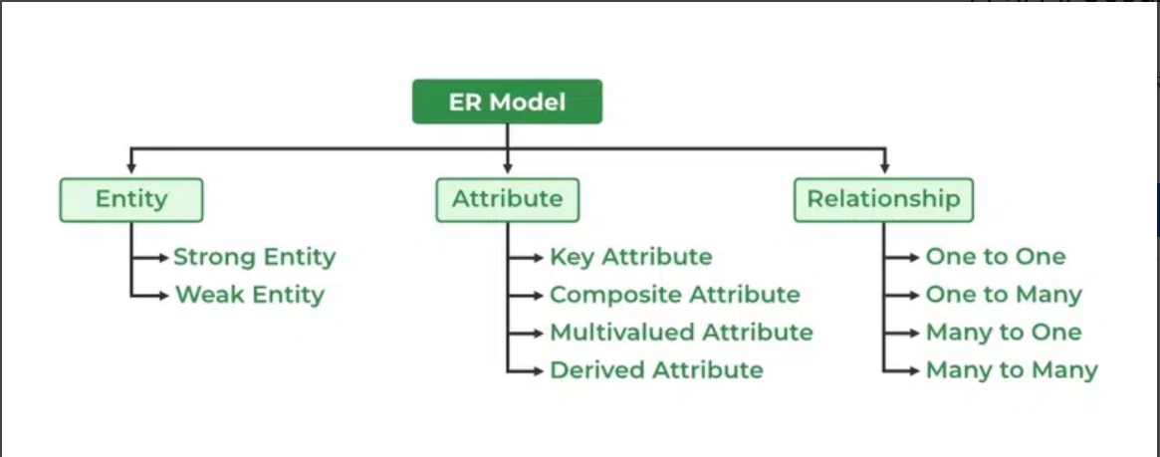
Components of ER Diagram
ER Model consists of Entities, Attributes, and Relationships among Entities in a Database System.

Slide 5
What is Entity?
An Entity may be an object with a physical existence – a particular person, car, house, or employee – or it may be an object with a conceptual existence – a company, a job, or a university course .
What is Entity Set?
An Entity is an object of Entity Type and a set of all entities is called an entity set.
For Example, E1 is an entity having Entity Type Student and the set of all students is called Entity Set.
In ER diagram, Entity Type is represented as:

Slide 6
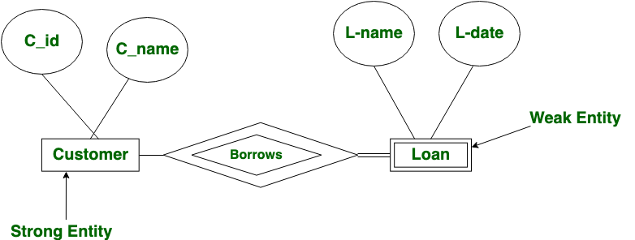
What is a Strong Entity?
A strong entity is not dependent on any other entity in the schema.
A strong entity will always have a primary key. Strong entities are represented by a single rectangle.
The relationship of two strong entities is represented by a single diamond.
Various strong entities, when combined together, create a strong entity set.
What is a Weak Entity?
A weak entity is dependent on a strong entity to ensure its existence.
Unlike a strong entity, a weak entity does not have any primary key.
It instead has a partial discriminator key.
A weak entity is represented by a double rectangle.
The relation between one strong and one weak entity is represented by a double diamond.
This relationship is also known as an identifying relationship.

Slide 7
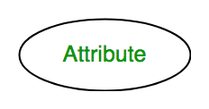
What is Attributes?
Attributes are the properties that define the entity type.
For example, Roll_No, Name, DOB, Age, Address, and Mobile_No are the attributes that define entity type Student.
In ER diagram, the attribute is represented by an oval.

Slide 8
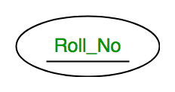
Types of Attributes
1. Key Attribute
The attribute which uniquely identifies each entity in the entity set is called the key attribute.
For example, Roll_No will be unique for each student.
In ER diagram, the key attribute is represented by an oval with underlying lines.

Slide 9
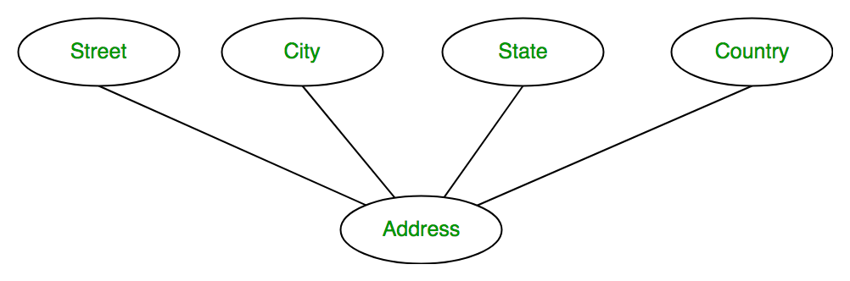
Composite Attribute
An attribute composed of many other attributes is called a composite attribute.
For example, the Address attribute of the student Entity type consists of Street, City, State, and Country.
In ER diagram, the composite attribute is represented by an oval comprising of ovals.

Slide 10
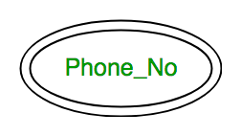
Multivalued Attribute
An attribute consisting of more than one value for a given entity.
For example, Phone_No (can be more than one for a given student).
In ER diagram, a multivalued attribute is represented by a double oval.

Slide 11
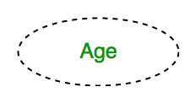
Derived Attribute
An attribute that can be derived from other attributes of the entity type is known as a derived attribute. e.g.; Age (can be derived from DOB).
In ER diagram, the derived attribute is represented by a dashed oval.

Slide 12
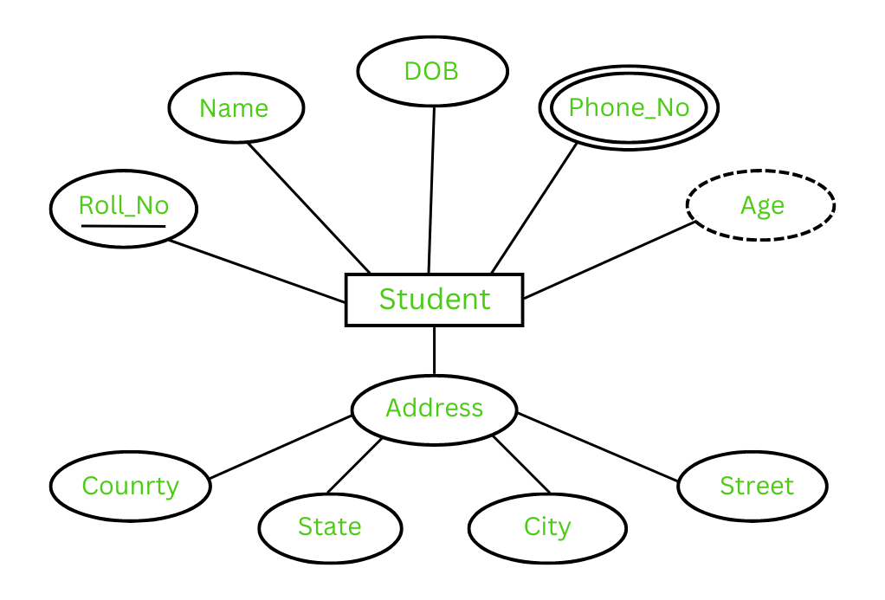
The Complete Entity Type Student with its Attributes can be represented as:

Slide 13
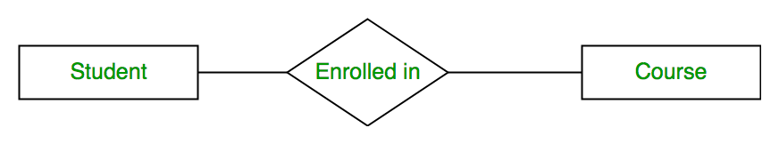
Relationship Type and Relationship Set
A Relationship Type represents the association between entity types.
For example, ‘Enrolled in’ is a relationship type that exists between entity type Student and Course.
In ER diagram, the relationship type is represented by a diamond and connecting the entities with lines.

Slide 14
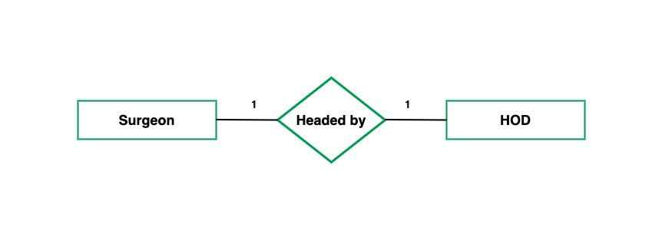
One-to-One: When each entity in each entity set can take part only once in the relationship, the cardinality is one-to-one.
Let us assume that a male can marry one female and a female can marry one male.
So the relationship will be one-to-one.
the total number of tables that can be used in this is 2.

Slide 15
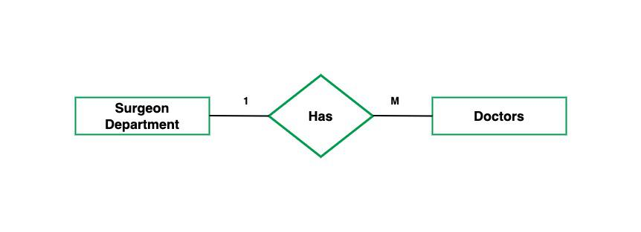
One-to-Many: In one-to-many mapping as well where each entity can be related to more than one entity and the total number of tables that can be used in this is 2.
Let us assume that one surgeon department can accommodate many doctors.
So the Cardinality will be 1 to M.
It means one department has many Doctors.
total number of tables that can used is 3.

Slide 16
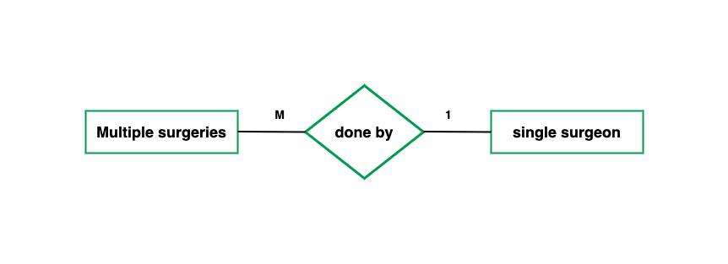
Many-to-One: When entities in one entity set can take part only once in the relationship set and entities in other entity sets can take part more than once in the relationship set, cardinality is many to one.
Let us assume that a student can take only one course but one course can be taken by many students.
So the cardinality will be n to 1. It means that for one course there can be n students but for one student, there will be only one course.
The total number of tables that can be used in this is 3.

Slide 17
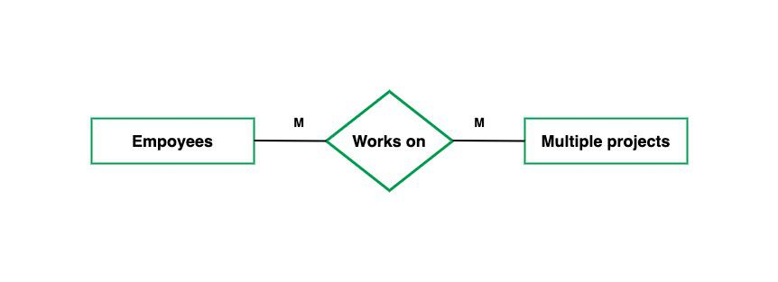
Many-to-Many: When entities in all entity sets can take part more than once in the relationship cardinality is many to many.
Let us assume that a student can take more than one course and one course can be taken by many students.
So the relationship will be many to many.
the total number of tables that can be used in this is 3.

Slide 18
How to Draw ER Diagram?
The very first step is Identifying all the Entities, and place them in a Rectangle, and labeling them accordingly.
The next step is to identify the relationship between them and place them accordingly using the Diamond, and make sure that, Relationships are not connected to each other.
Attach attributes to the entities properly.
Remove redundant entities and relationships.
Add proper colors to highlight the data present in the database.

Slide 19

ERD notations guide
An ER Diagram contains entities, attributes, and relationships.
In this section, we will go through the ERD symbols in detail.
Entity
An ERD entity is a definable thing or concept within a system, such as a person/role (e.g. Student), object (e.g. Invoice), concept (e.g. Profile) or event (e.g. Transaction) (note: In ERD, the term "entity" is often used instead of "table", but they are the same).
When determining entities, think of them as nouns.
In ER models, an entity is shown as a rounded rectangle, with its name on top and its attributes listed in the body of the entity shape.
The ERD example below shows an example of an ER entity.

Slide 20
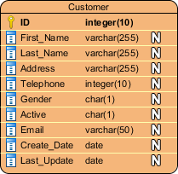
Entity Attributes
Also known as a column, an attribute is a property or characteristic of the entity that holds it.
An attribute has a name that describes the property and a type that describes the kind of attribute it is, such as varchar for a string, and int for integer.
When an ERD is drawn for physical database development, it is important to ensure the use of types that are supported by the target RDBMS.
The ER diagram example below shows an entity with some attributes in it.

Slide 21
Relationship
A relationship between two entities signifies that the two entities are associated with each other somehow.
For example, a student might enroll in a course.
The entity Student is therefore related to Course, and a relationship is presented as a connector connecting between them.

Slide 22
